Slide 1

Resume Classification
Data set details :
Resumes and financial documents
MEMBERS:
MUHAMMED ADILSHA TP
MALLIKARJUNA REDDY
SAKSHI SHAILESH PISAL
VISHAL KAKASAHIB DUKARE
RITESH SUNIL DHARMEKAMBELE
NEHA BHAGWAT BIDWE

Slide 2
Business objective-
The document classification solution should significantly reduce the manual human effort in the HRM. It should achieve a higher level of accuracy and automation with minimal human intervention
Objective describing position you seek. Profile giving summary of your talents and experience. Experience listing your position, employer and dates.

Slide 3
Introduction
Using the conventional method of recruitment, an organization's HR department invites individuals based on their resumes to an interview for a specific position. This HR department manually evaluates a candidate's skills based on their résumé to determine if he or she is qualified for the position or not. HR’s conduct interviews, and the panel plays a significant role in determining who is the best applicant for the post. They examine not just the candidate's talents, but also his or her personality. Maintaining resumes and profiles of all candidates becomes a very tedious job when it comes to big mass recruitment companies because they provide employment in bulk, and thus maintaining or storing data physically is not possible.

Slide 4
Project Architecture / Project Flow
. Proposed Flowchart for the system First the dataset needs to be scraped which can be done using various websites like indeed.com, glassdoor.com and kaggle.com. Once the dataset has been scrapped, preprocessing of data is to be done by doing proper stemming and lemmatization, removing stop words and filler words store the relevant words in a separate column for further process. After the preprocessing of data is done, making sure that the relevant data have the words which have occurred the highest amount of times need to be put in a term-frequency document using TFIDF Vectorization. Once the previous steps are done, the cleaned data is now ready to test and form classification models using machine learning algorithms. Analysing the model by their accuracy and the forming confusion matrix for the same is required for better understanding of the results.

Slide 5
Challenges
The problem is that the present are not much flexible and efficient and time saving. It requires candidate, to fill the forms online than also you might not get the genuine information of the candidate. Beside Where our system which saves the time of the candidate by providing to upload there resume in any format preferable to the candidate beside all the information in the resume our system will detect all its activity from the candidate social profile which will give the best candidate for that particular job and candidate will also be satisfied because he will get job in that company which really appreciates candidates skill and ability. On the other hand we are providing same kind of flexibility to the client company

Slide 6

Exploratory Data Analysis
(EDA)
Feature Engineering

Slide 7
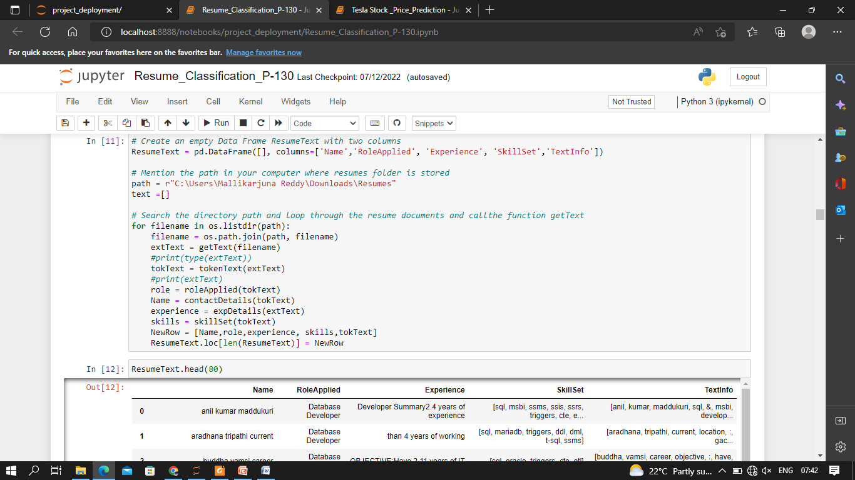

Slide 8
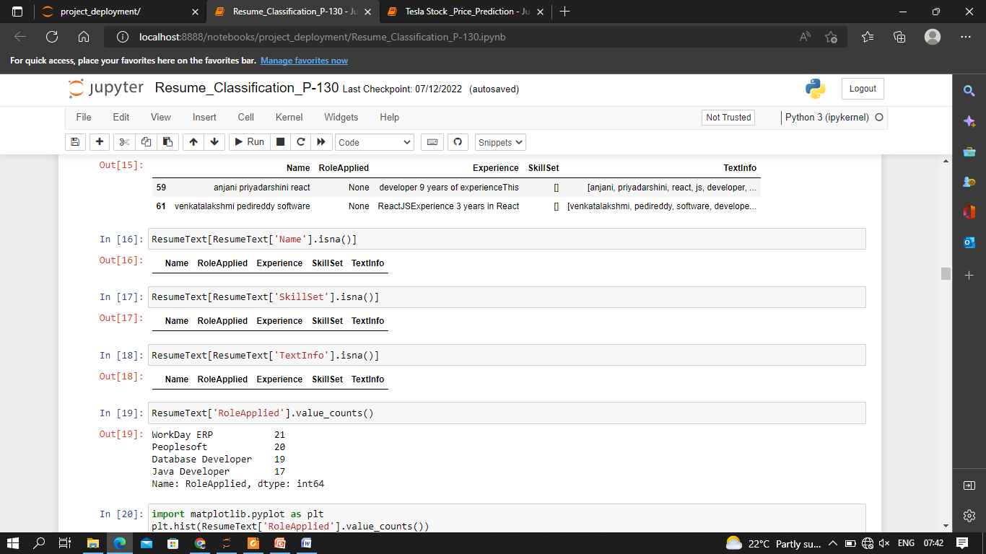

Slide 9
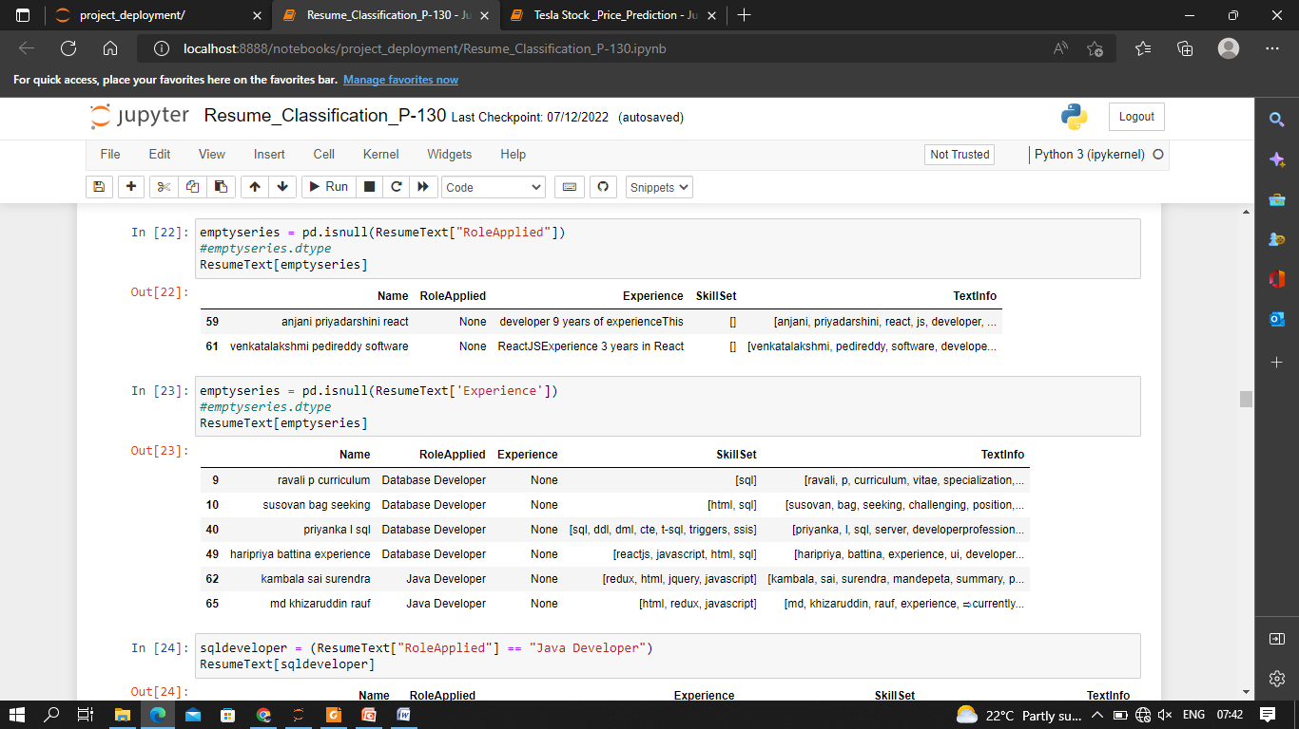

Slide 10
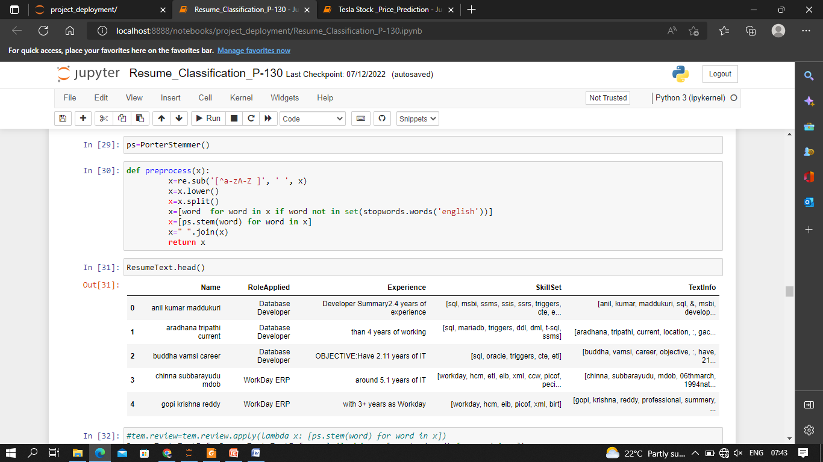

Slide 11
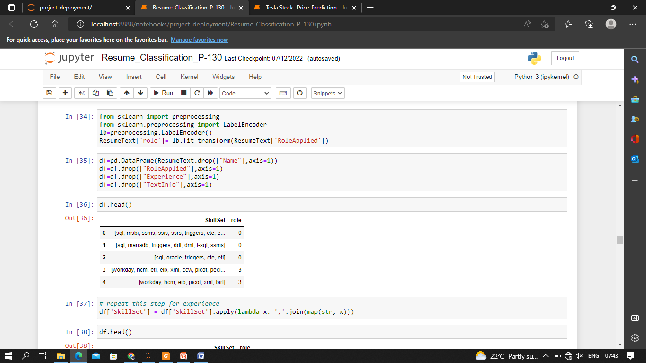

Slide 12
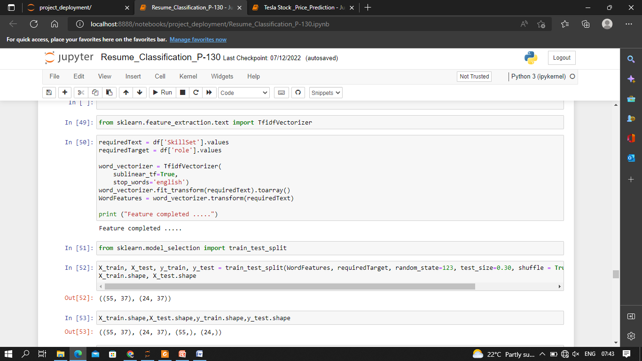

Slide 13
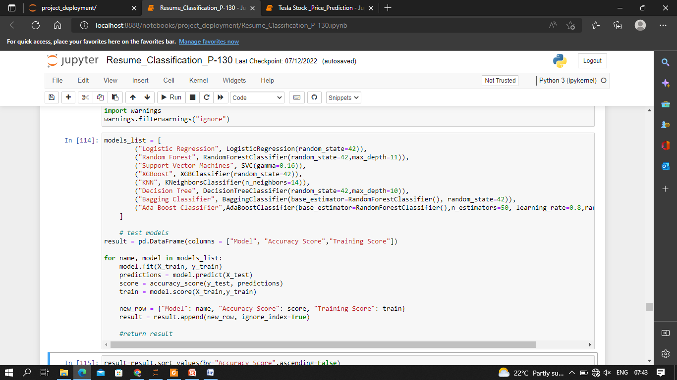

Slide 14
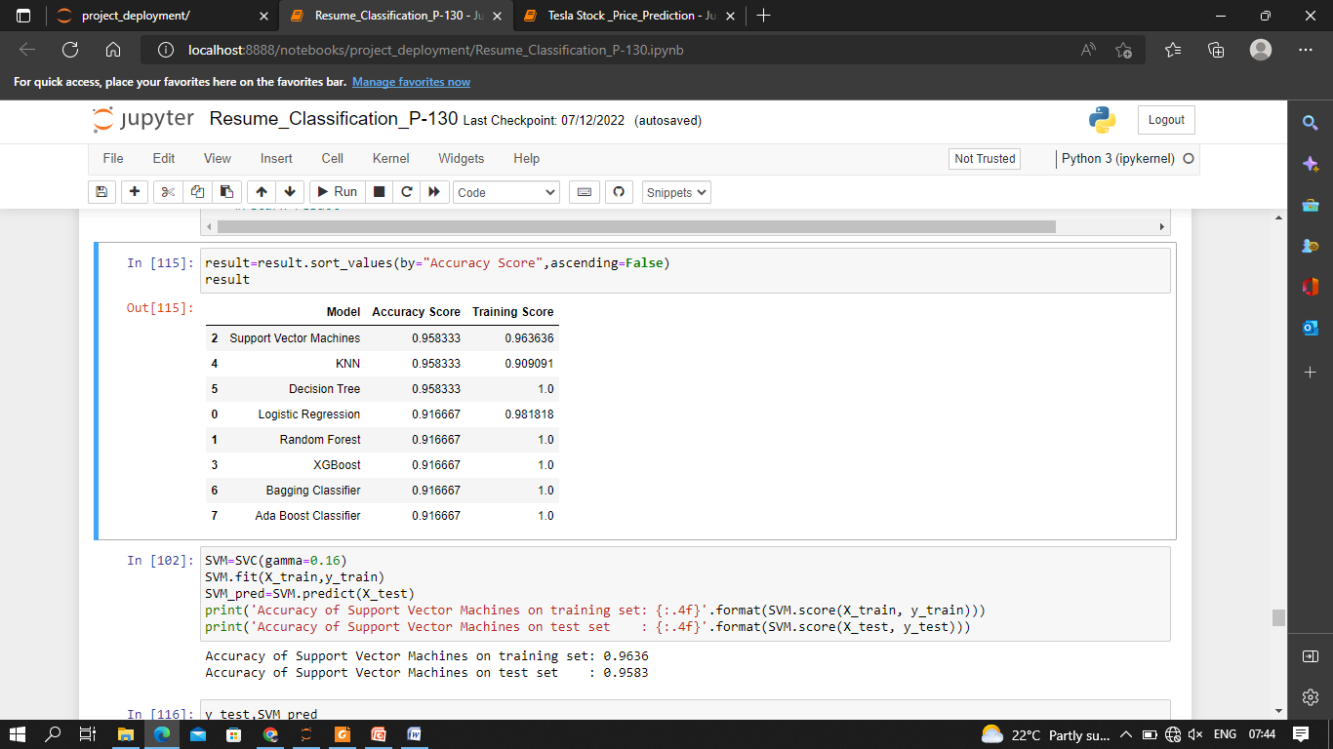

Slide 15
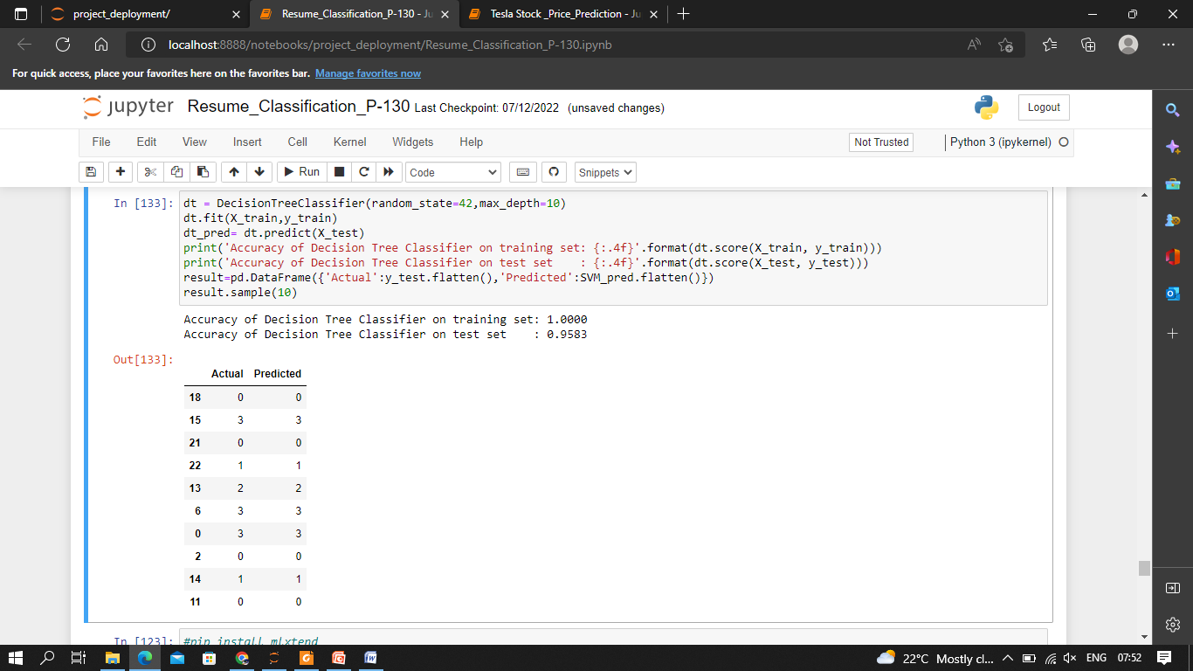

Slide 16
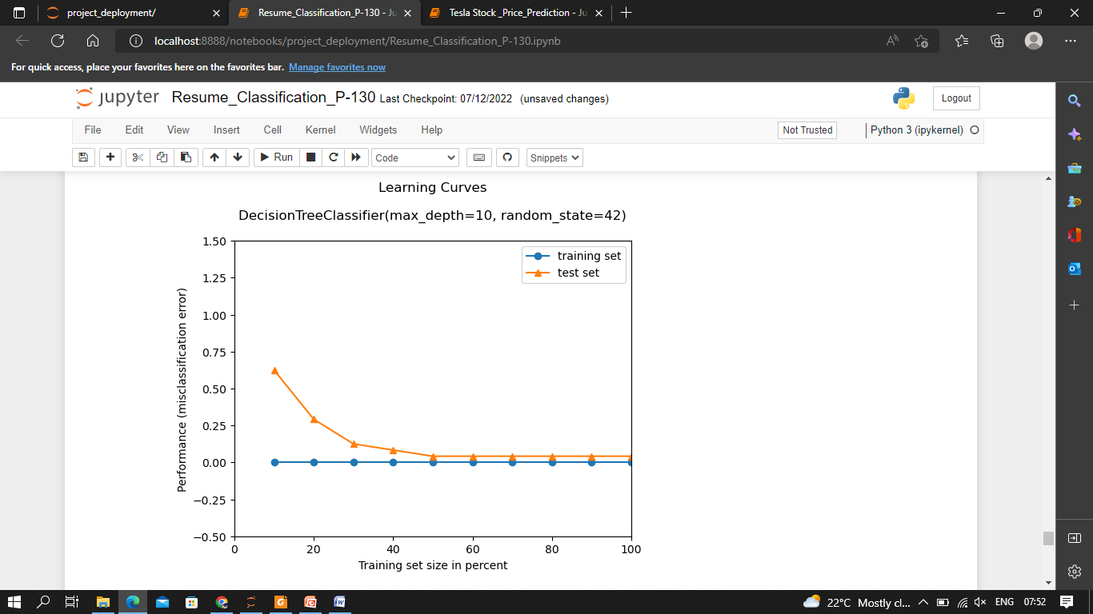

Slide 17

Module building

Slide 18
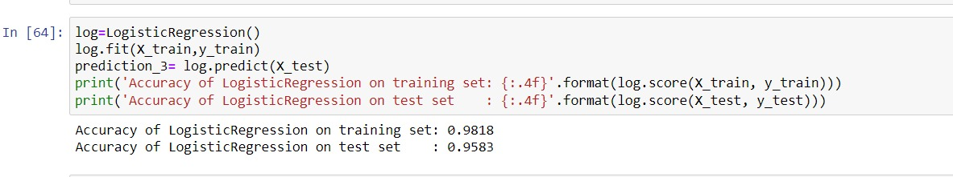

Slide 19
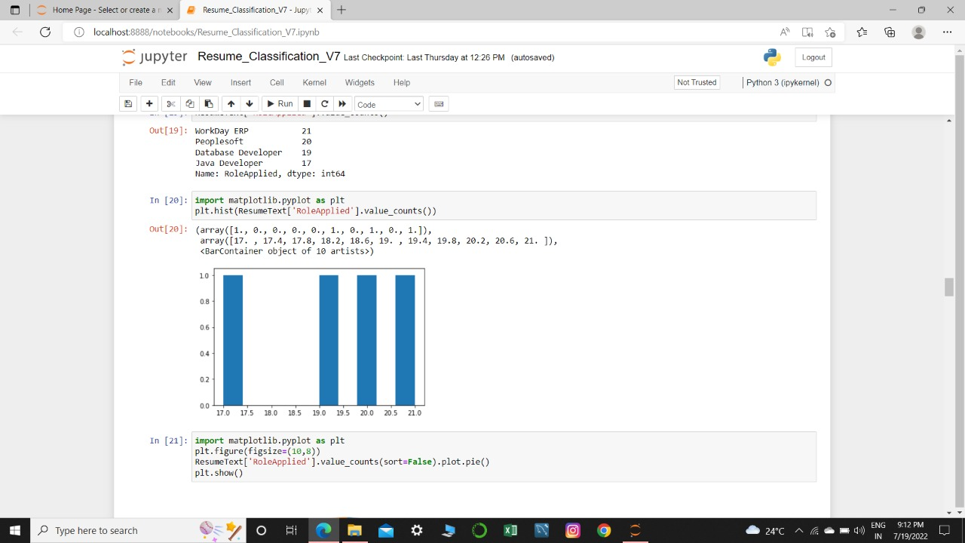

Slide 20
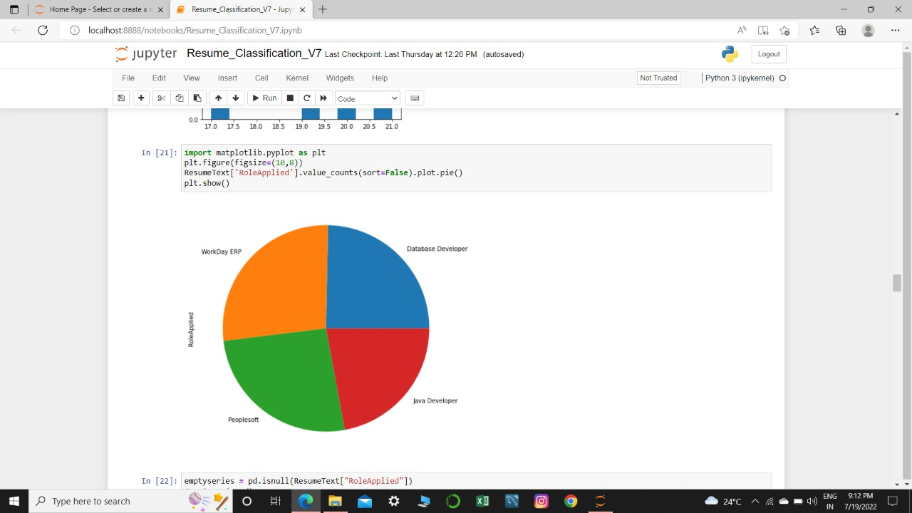

Slide 21

Deployment

Slide 22
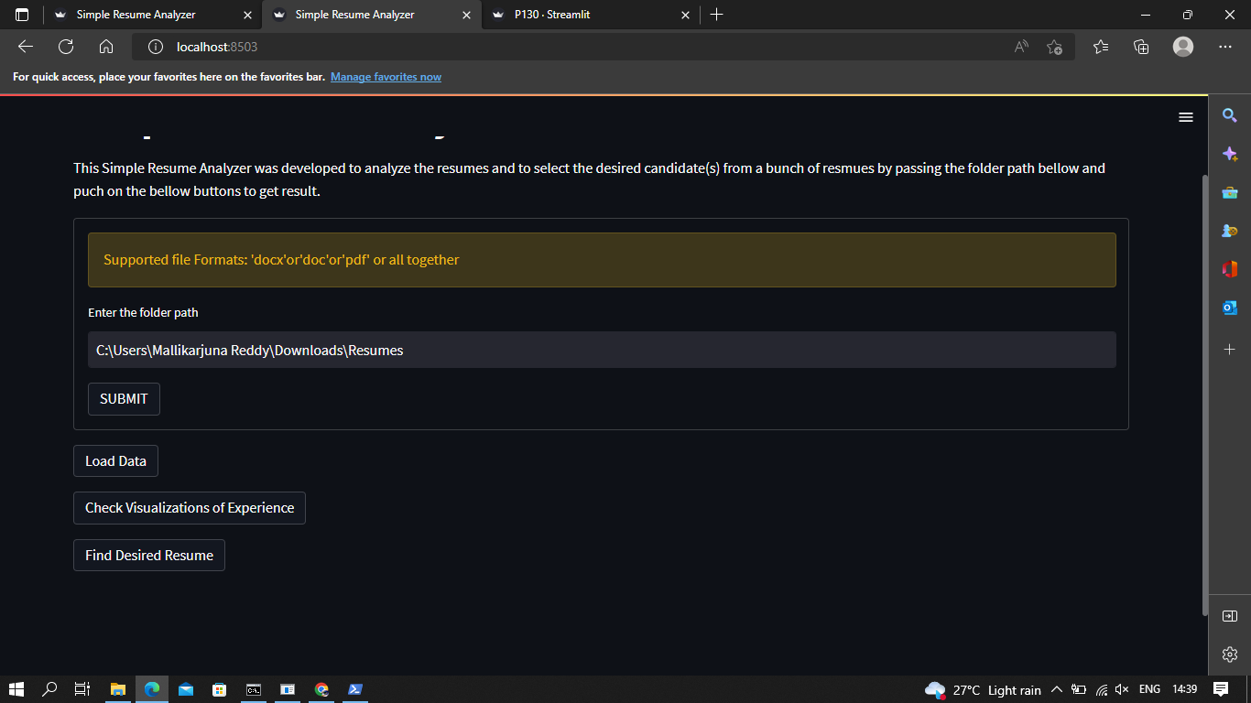

Slide 23
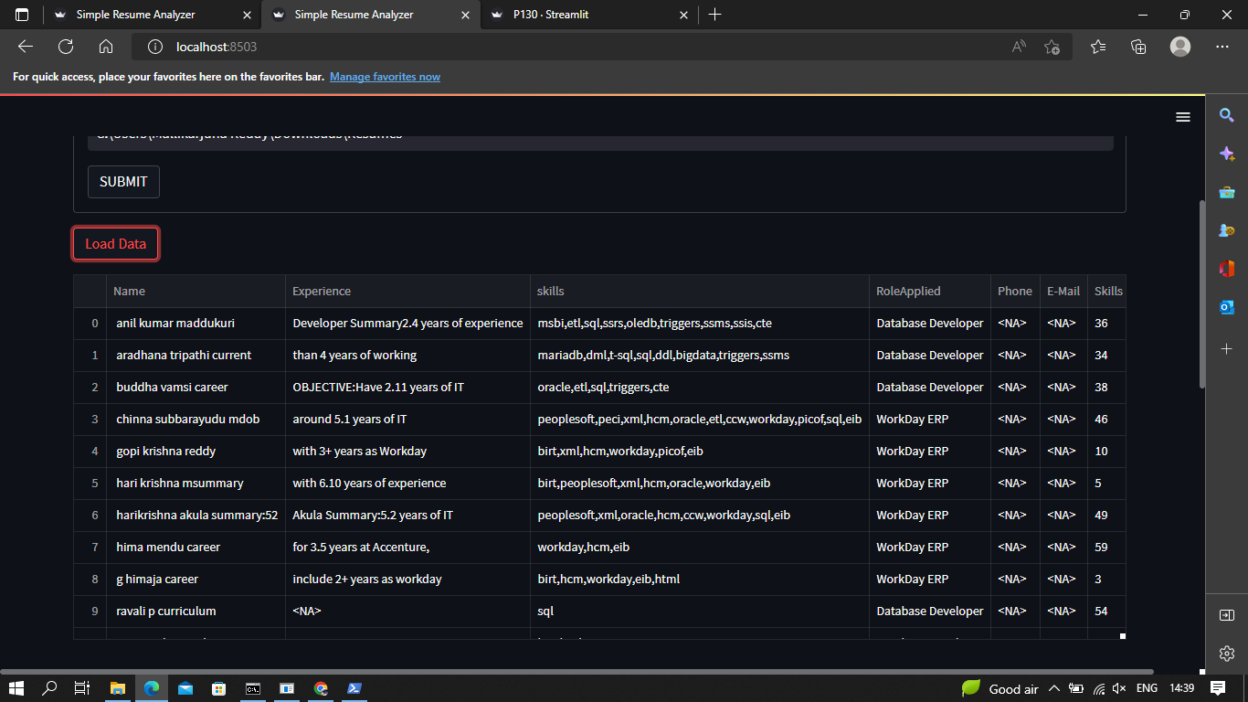

Slide 24
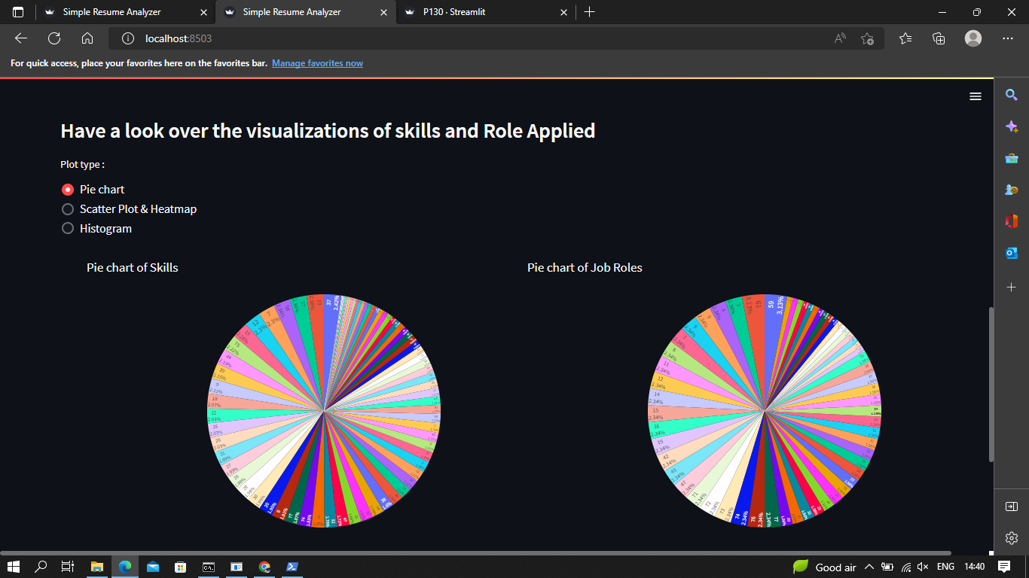
Add a Slide Title - 1

Slide 25
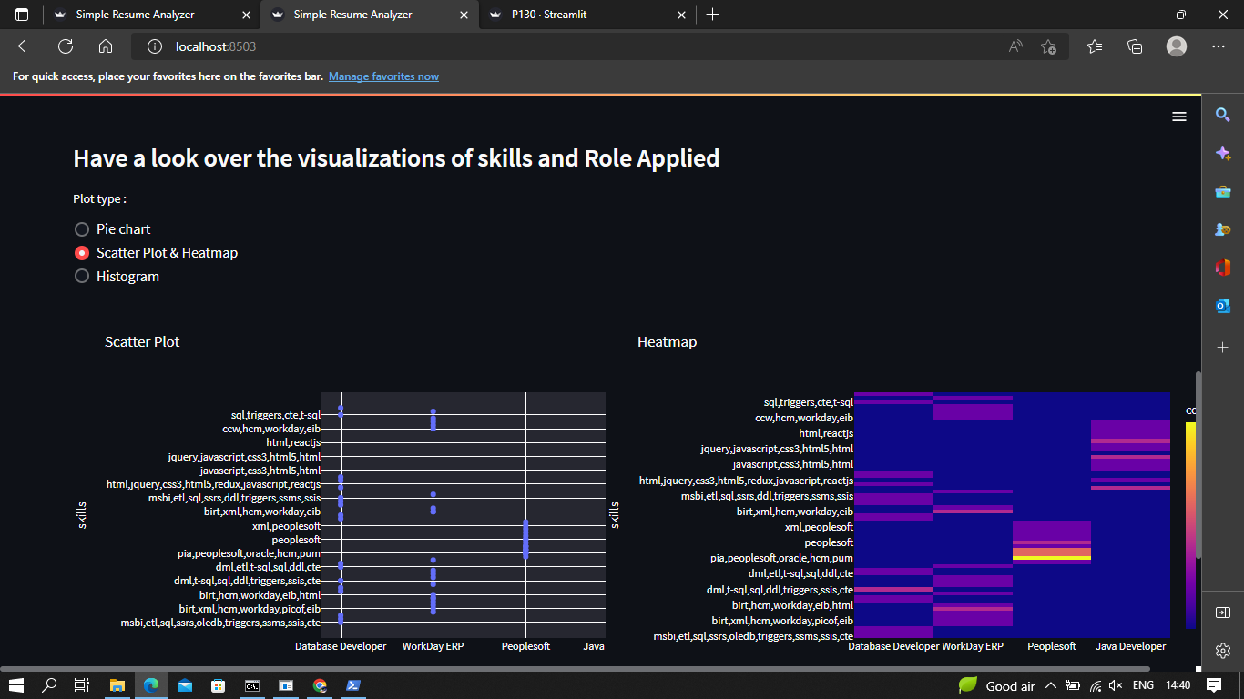
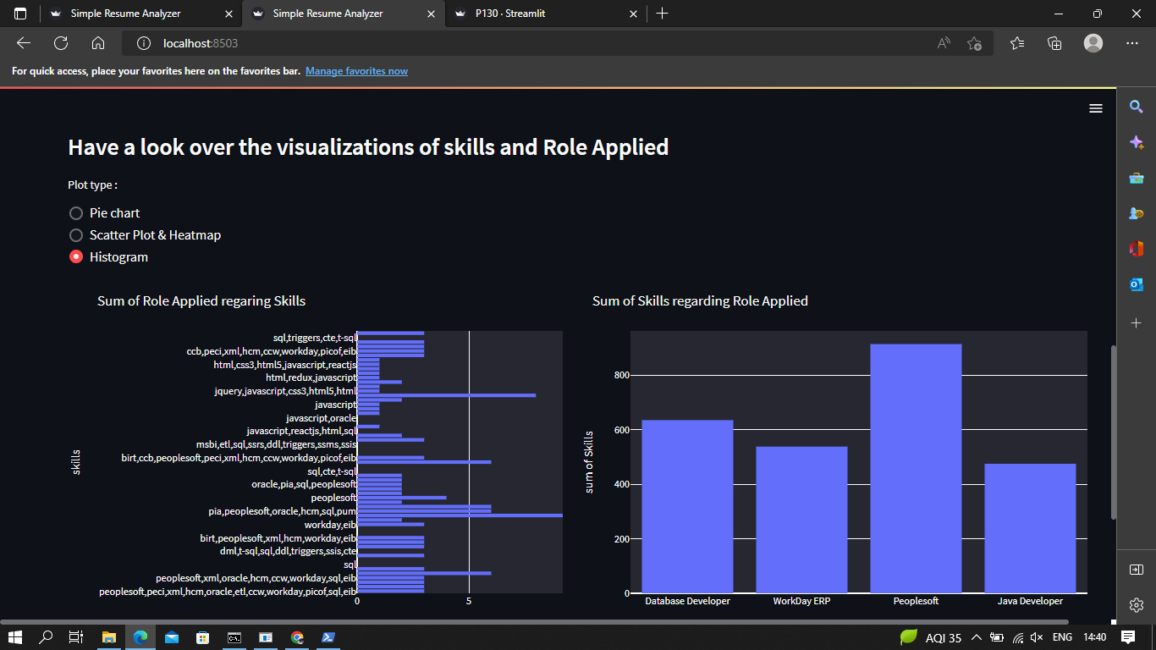
Add a Slide Title - 2

Slide 26
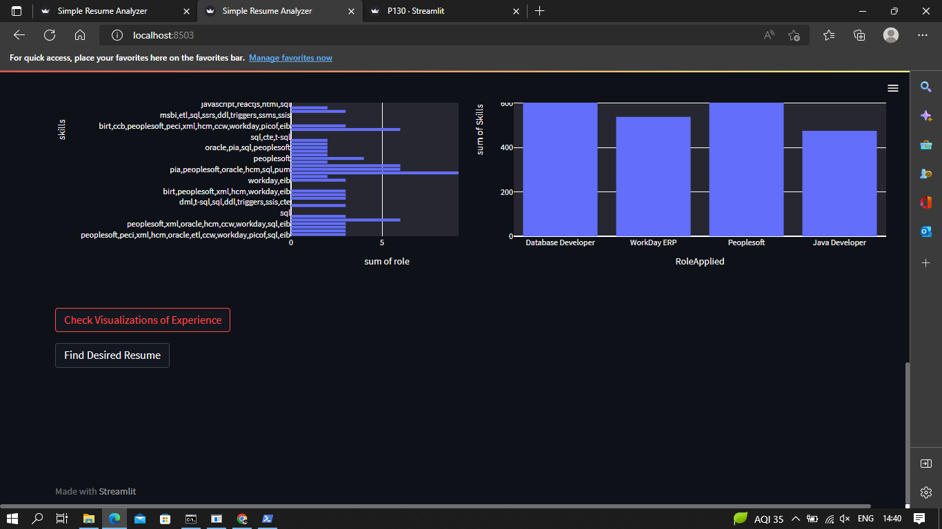
Add a Slide Title - 3

Slide 27
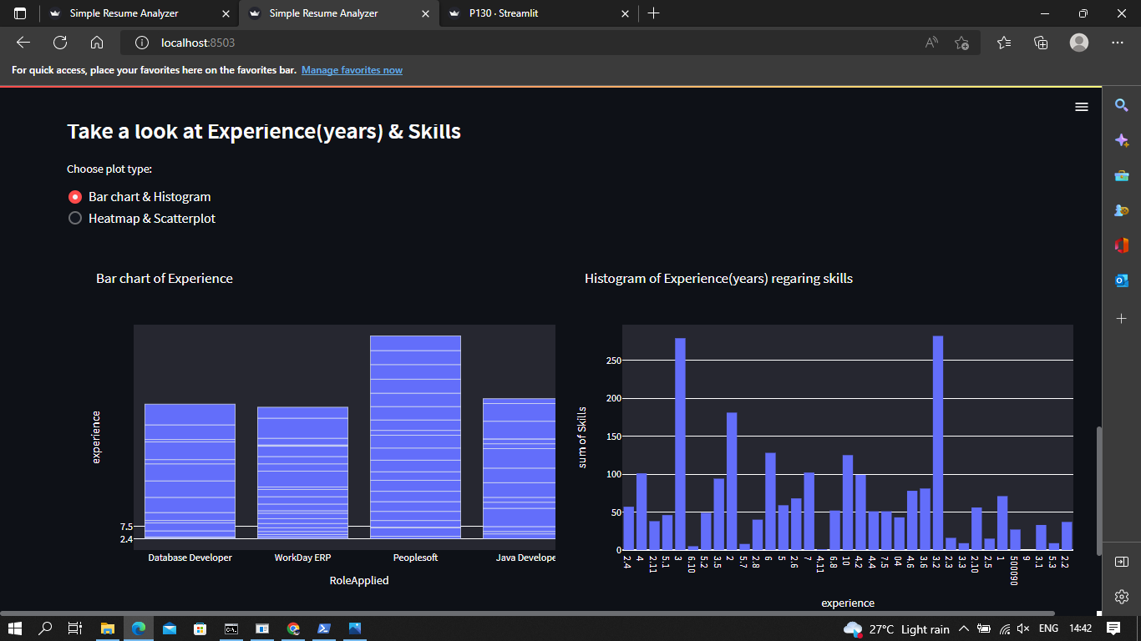

Slide 28
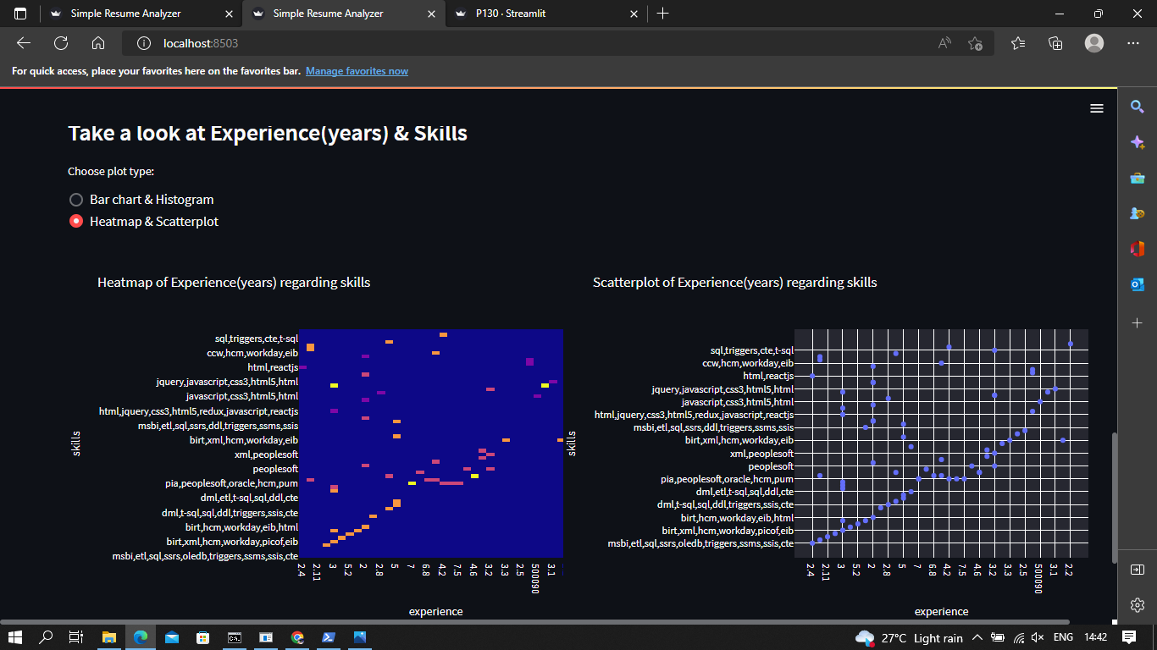

Slide 29
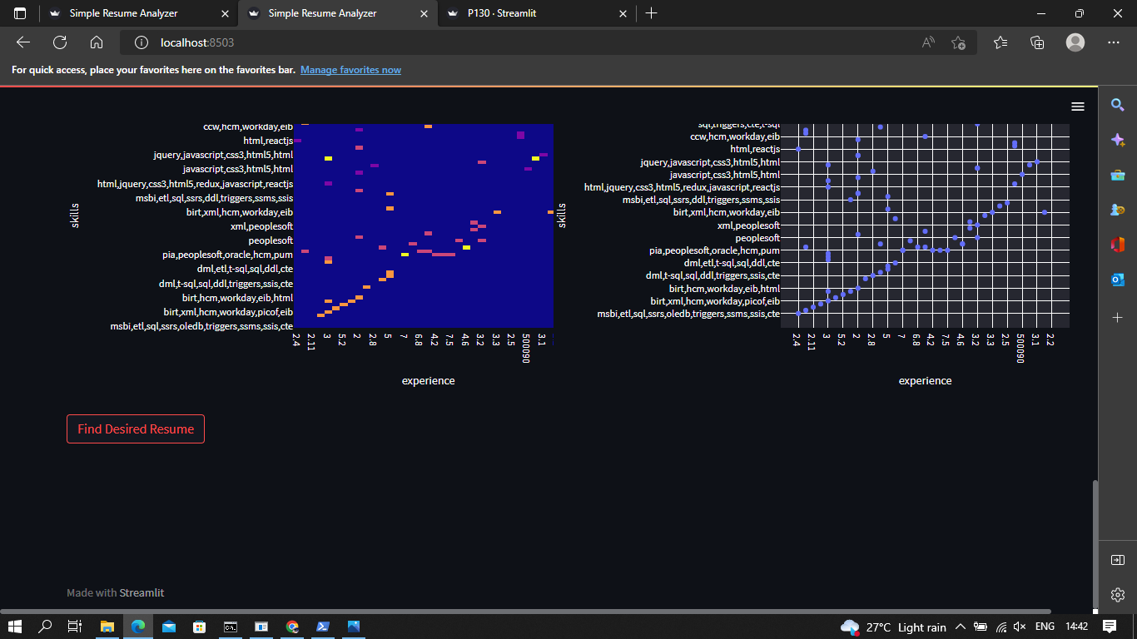

Slide 30
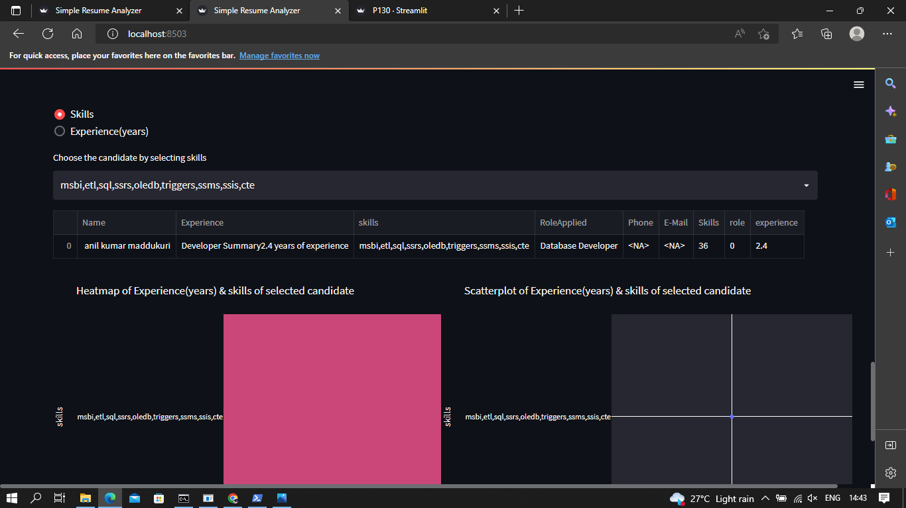

Slide 31
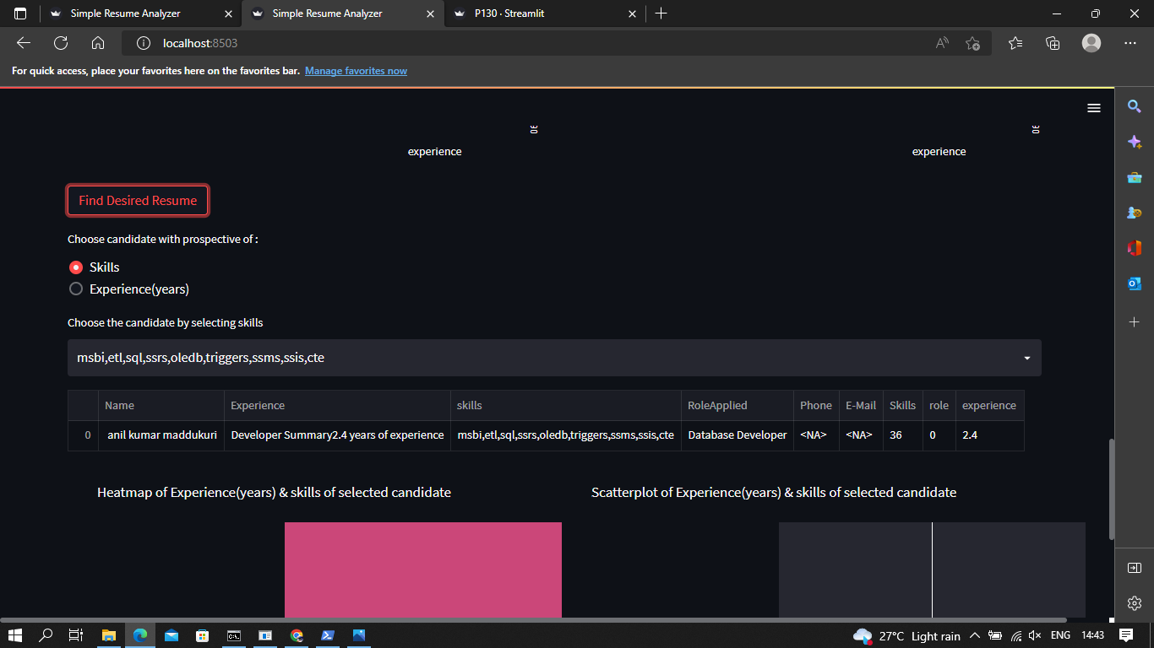

Slide 32
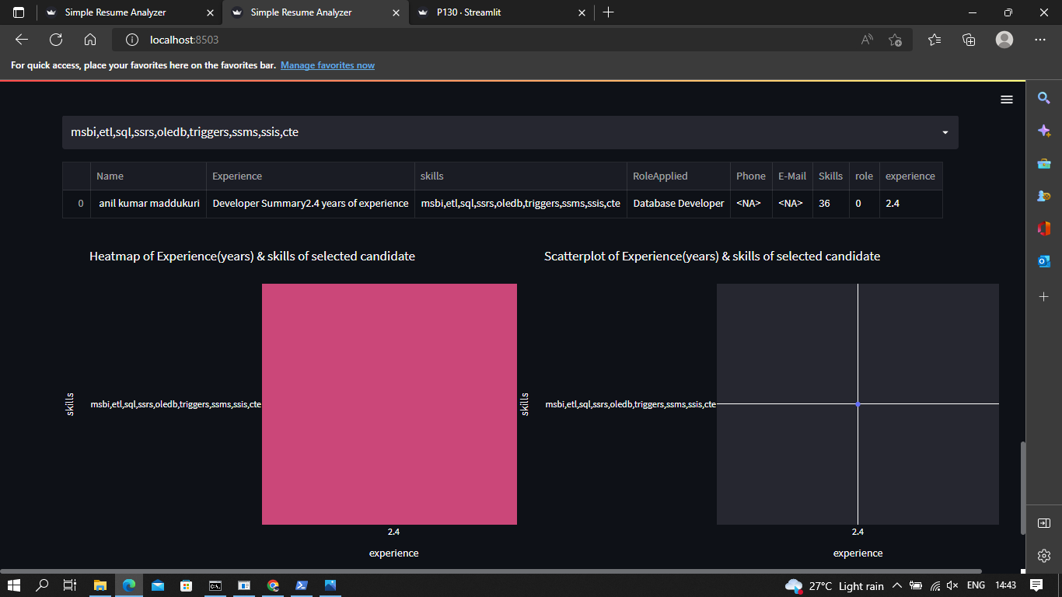

Slide 33
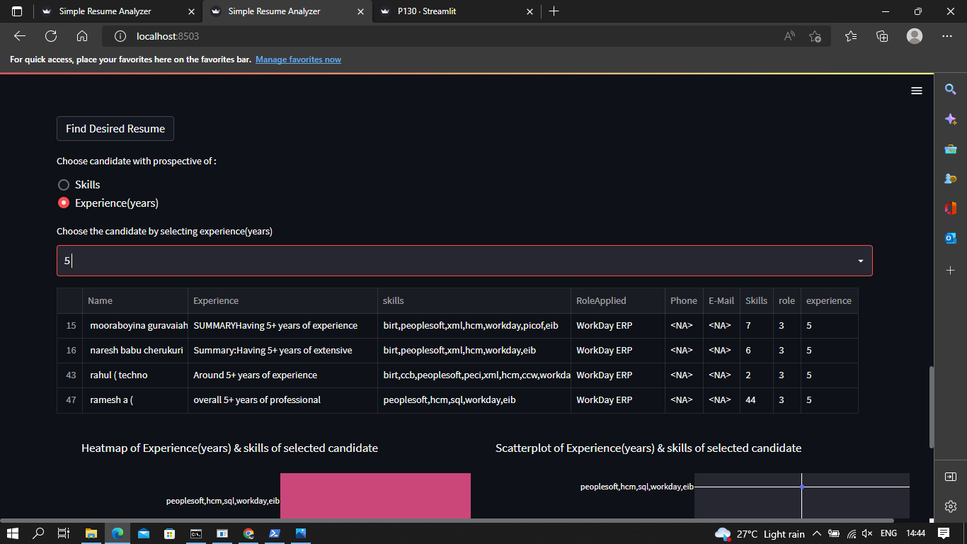

Slide 34
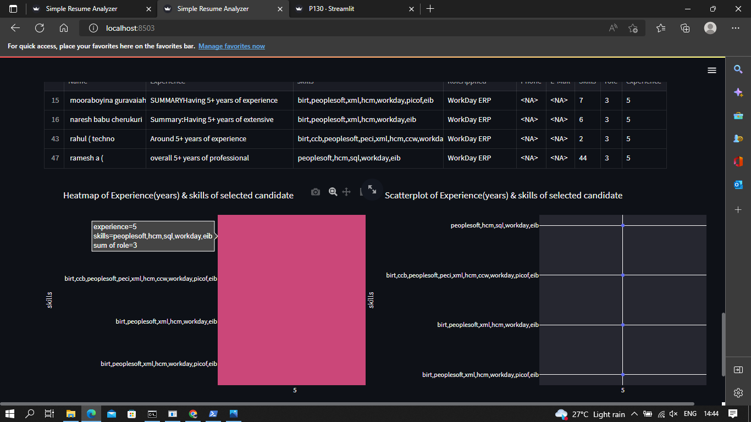

Slide 35
CONCLUSION AND FUTURE WORK :
We have compared the various state of the art algorithms
using similar self-generated data which allowed us to compare
them in an unbiased way. The data generation was the most
challenging task as the data we generated is very sensitive data
and is not accessible for everyone easily. Further, the data was
raw and it had more deformities, so we had to clean it up
various times Conclusion and Future Scope 9.1 Conclusion Our system will provide better and efficient solution to current hiring process. This will provide potential candidate to the organisation and the candidate will be successfully be placed in an organisation which appreciate his/her skillset and ability

Slide 36


